Slide 1

8th Grade Math: Pre-Algebra
Unit 7, Lesson 2 Slope in Real-World Contexts Volume 1, pg. 288

Slide 2


Benchmarks
MA.8.AR.3.2
Given a table, graph, or written description of a linear relationship, determine the slope.
MA.8.AR.3.5
Given a real-world context, determine and interpret the slope and 𝑦-intercept of a two-variable linear equation from a written description, a table, a graph, or an equation in slope-intercept form.
volume 1, pg. 288

Slide 3
Integrated Mathematical Thinking and Reasoning Standard
MA.K12.MTR.7.1 Apply mathematics to real-world contexts.
volume 1, pg. 288

Slide 4

Learning Targets
I can determine the slope from a graph, table, or written description in a real-world context.
I can interpret the slope as the rate of change in a real-world context.
volume 1, pg. 288

Slide 5

Warm-Up
volume 1, pg. 288

Slide 6

7.2.1 Warm-Up: Graph the Story
Watch the video of the person stacking styrofoam cups.
Create a sketch of the graph to represent the height of the stack, in centimeters, over time.
Height of Stack
(centimeters)
Time (seconds)
volume 1, pg. 288

Slide 7

Guided Instruction
volume 1, pg. 289

Slide 8

7.2.2 Guided Instruction: Finding and Interpreting Slope in Context
A linear relationship is any relationship between two quantities, where one quantity has a constant rate of change with respect to the other. This means that one quantity is increasing or decreasing the same amount for every equal-sized interval of the other quantity.
Linear relationships can be used to model real-world contexts in which the quantities are changing at a constant rate. Three different representations of the same linear relationship are shown.
volume 1, pg. 289

Slide 9
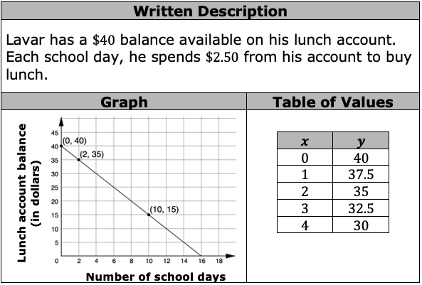
Use the graph to find the slope of the line.
Use the table to find the slope of the line.
volume 1, pg. 289

Slide 10
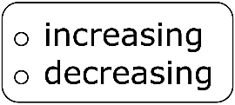
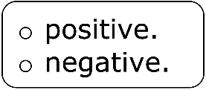
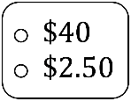
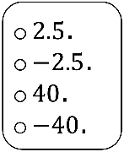
The written description of the relationship can also be used to find the slope.
Use the written description to complete the statements describing how to find the slope.
The balance of Lavar’s lunch account is each school day, so the slope is It changes by each school day, so the slope is
volume 1, pg. 289

Slide 11
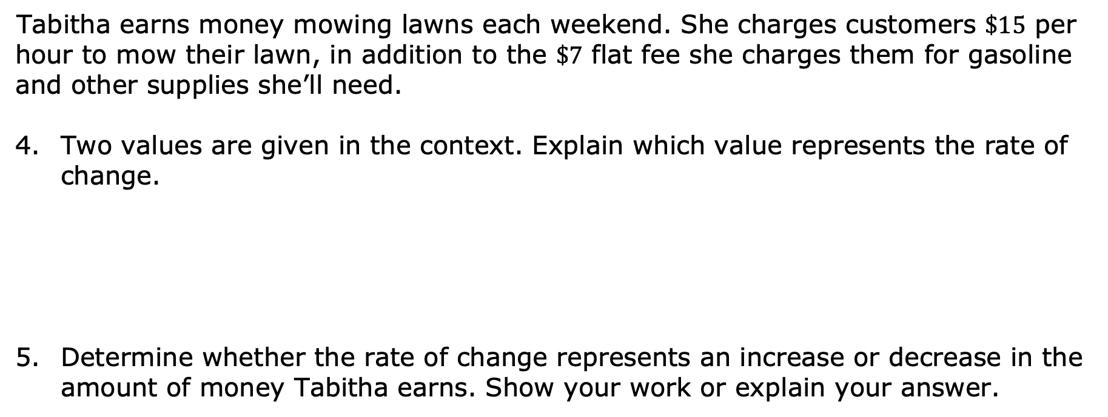
Tabitha earns money mowing lawns each weekend. She charges customers $\$15$ per hour to mow their lawn, in addition to the $\$7$ flat fee she charges them for gasoline and other supplies she’ll need.
Two values are given in the context. Explain which value represents the rate of change.
Determine whether the rate of change represents an increase or decrease in the amount of money Tabitha earns. Show your work or explain your answer.
volume 1, pg. 289

Slide 12
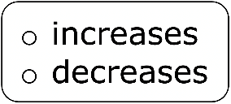

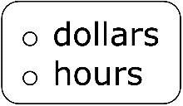
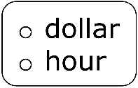
Based on the answers to the previous questions, what is the slope in this linear relationship?
Complete the statement to interpret the slope as the rate of change for this context.
In this context, the slope means that the amount of money Tabitha earns by for every she mows a customer’s lawn.
volume 1, pg. 290

Slide 13

The slope is the rate of change that one quantity is changing by in terms of another quantity. When interpreting the rate of change in a real-world context, units for both quantities are included.
volume 1, pg. 290

Slide 14

Guided Practice
volume 1, pg. 290

Slide 15

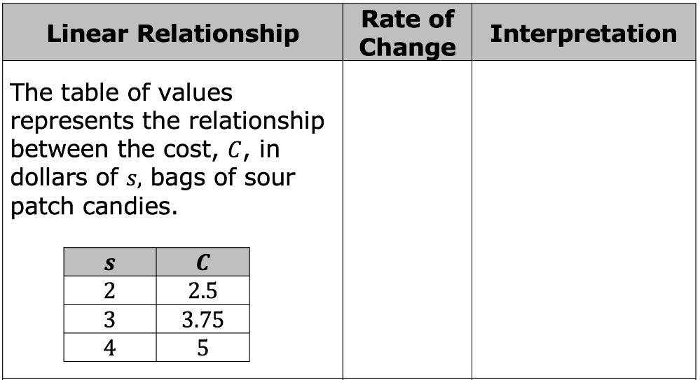
7.2.3 Guided Practice: Relating Slope to Rate of Change in Real-World Context
For each linear relationship, determine the rate of change and interpret its meaning in the given context.
volume 1, pg. 290

Slide 16
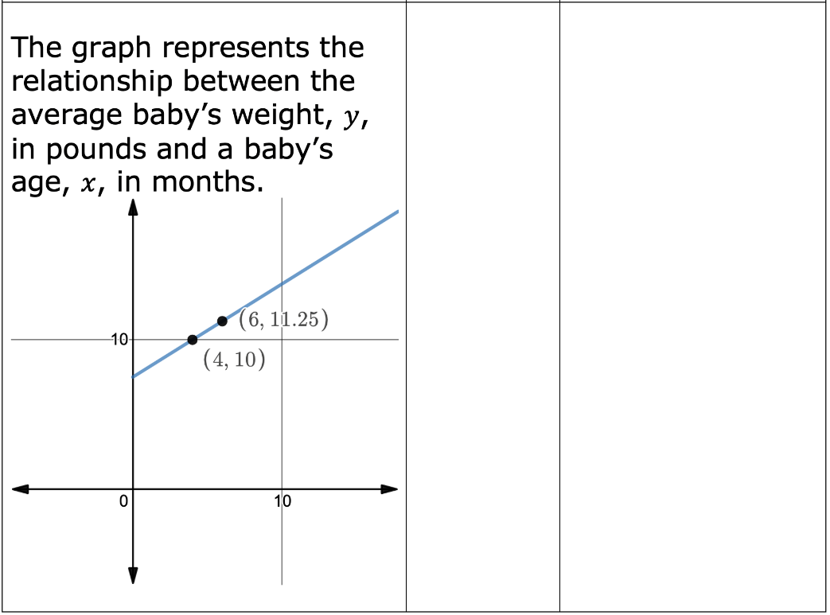
volume 1, pg. 290

Slide 17
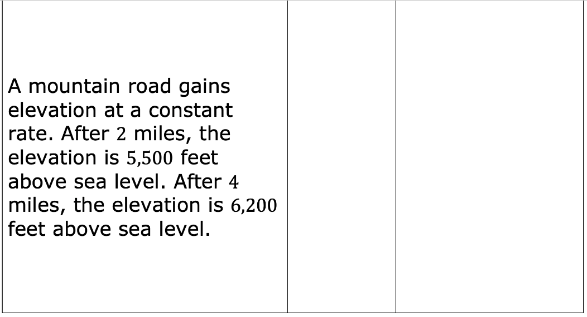
volume 1, pg. 291

Slide 18

Your Turn
volume 1, pg. 291

Slide 19

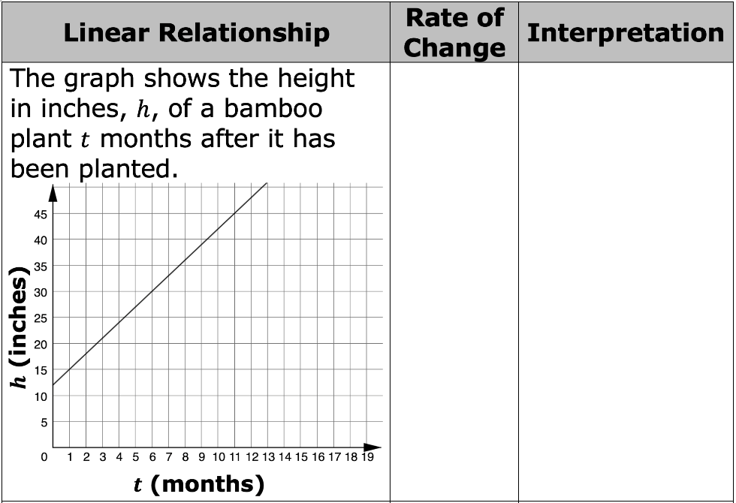
7.2.4 Your Turn!
For each linear relationship, determine the rate of change and interpret its meaning in the given context.
volume 1, pg. 291

Slide 20
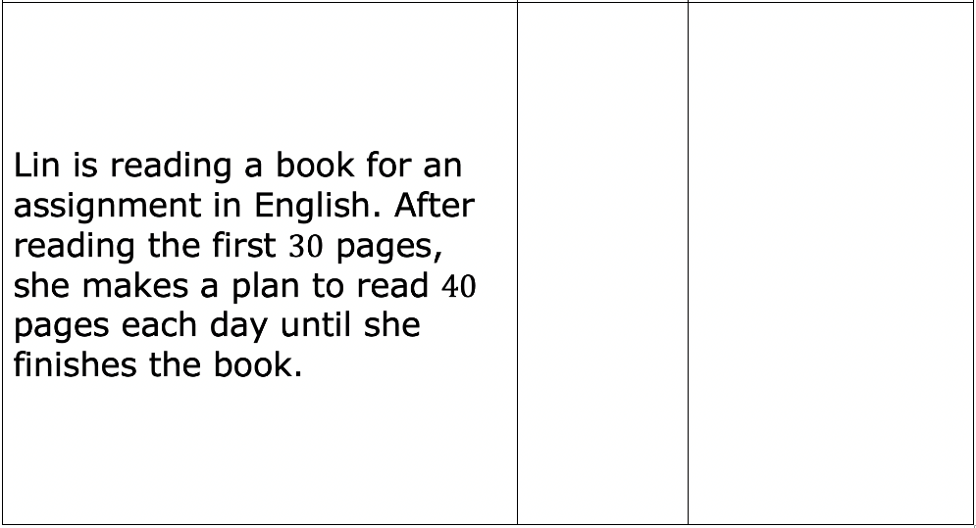
volume 1, pg. 291

Slide 21

Wrap-Up
volume 1, pg. 292

Slide 22
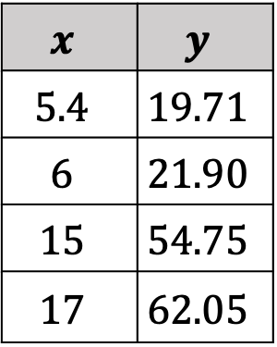
7.2.5 Wrap-Up: Ticket Out the Door
Yingjie tracked the cost of purchasing gasoline and the number of gallons he bought. His table is shown where 𝑥 represents the number of gallons purchased, and 𝑦 represents the cost in dollars.
$$x$$ | $$y$$
$$5.4$$ | $$19.71$$
$$6$$ | $$21.90$$
$$15$$ | $$54.75$$
$$17$$ | $$62.05$$
volume 1, pg. 292

Slide 23
What is the rate of change?
Interpret the rate of change.
volume 1, pg. 292

